Slide 1
Student Stress Level Prediction using Supervised Learning
Garrett Burgard,
Ayesha Siddiqua,
Khalid Hasan
7th December, 2023

Slide 2
Problem Statement
Stress can hinder a student's performance in college and their well being
Predict which stressors have the greatest impact

Slide 3
Dataset
Student stress factors: a comprehensive analysis
20 features, 1,100 samples
Psychological, Physiological, Social, Environmental, Academic factors

Slide 4
Dataset-Cont.
Psychological | Physiological | Environmental | Academic | Social
anxiety level | headache | noise level | academic performance | social support
self esteem | blood pressure | living conditions | study load | peer pressure
mental health history | sleep quality | safety | teacher student relationship | extracurricular activities
depression | breathing problem | basic needs | future career concerns | bullying

Slide 5
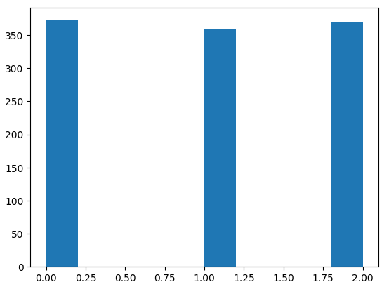
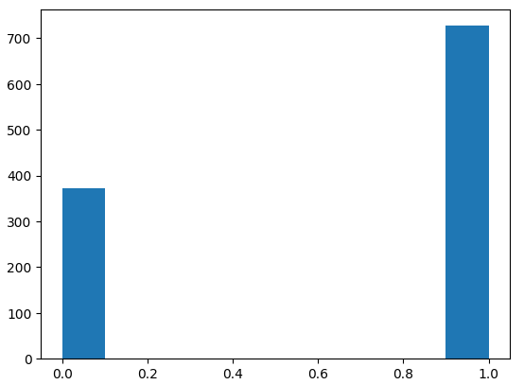
Data Preprocessing
Initially, three stress levels: 0, 1, 2
Labels 1 and 2 are merged as 1
After processing, two stress levels: 0 (No), 1(Yes)

Slide 6
Model Definition
Pipeline
Three classification models:
K-Nearest Neighbors
Decision Tree
Random Forest Tree
Three Pipelines for each model:
Each pipeline includes two stages: Standard scalar, and a model
Attributes
Standard Scalar
Classification Unit
Model

Slide 7
Model Tuning
To get the optimized model, we have tuned the models with different set of hyper-parameter.
Sklearn's GridSearchCV is used with 5-fold corss validation to construct parameter grids for hyperparameter tuning.
KNN
max_depth: range(1, 20)
n_estimators: range(1, 20)
n_neighbors: range(1, 40)
Decision Tree
Random Forest Tree
max_depth: range(1, 20)

Slide 8
Best Models
After finishing the model training stage with the different combinations of hyper-parameters -> best trained models with optimized hyper-parameters.
Classification Models | Parameters
KNN | n_neighbors: 19
Decision Tree | max_depth: 2
Random Forest Tree | max_depth: 3 n_estimators: 19

Slide 9
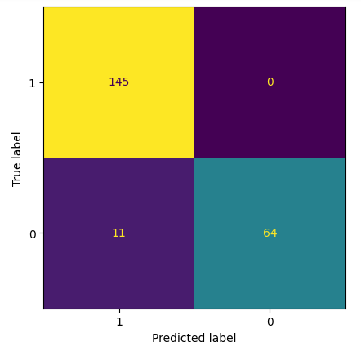
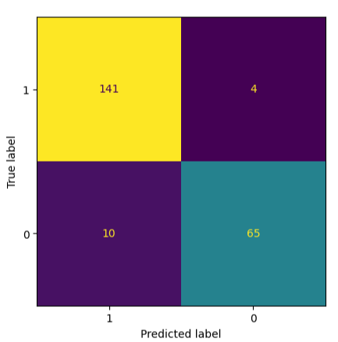
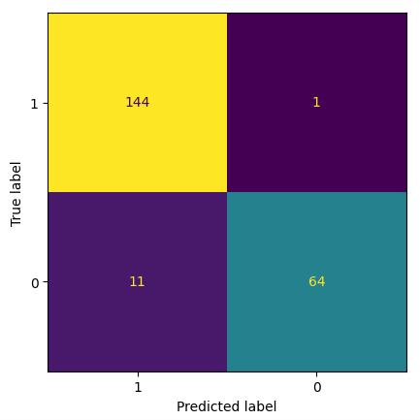
Model Evaluation
Model | F1 Score | Accuracy
KNN | 0.9489 | 0.9261
Decision tree | 0.9356 | 0.9284
Random Forest Tree | 0.9444 | 0.9340
KNN
Decision Tree
Random Forest

Slide 10
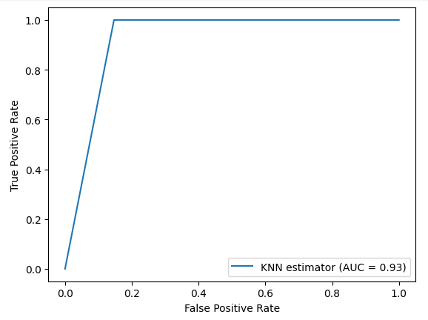
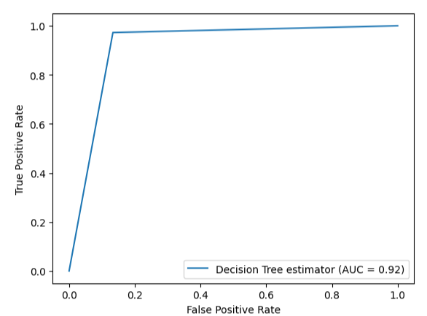
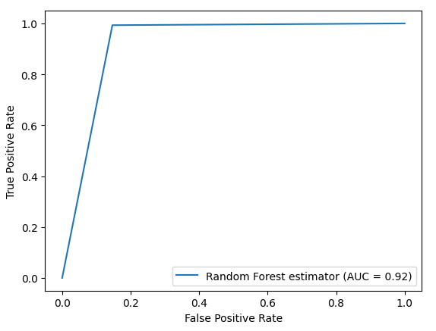
ROC Curve
An ROC curve shows the performance of a binary classifier model at different thresholds
A higher value of (Area under ROC curve) AUC indicates a better model quality

Slide 11
Conclusion
Overall, the KNN and random forest tree performed best
Larger dataset may impact the performance
In future, implementing neural network-based classification can improve the performance and scalability.

Slide 12
Thank You

